Slide 1

WiDS Kenya Data Drills: Classification Modeling
Classification modeling is a type of supervised learning where the goal is to predict the categorical class labels of new instances based on past observations.
Application:
Healthcare: Predicting the presence of diseases, such as diabetes or cancer, assessing foetal health, from patient data. Classification models can assist in early diagnosis and personalized treatment plans.
Finance: Detecting fraudulent transactions by analysing patterns in transaction data. Models can classify transactions as legitimate or fraudulent, helping prevent financial crimes.
Marketing: Segmenting customers based on purchasing behaviour and targeting specific groups with personalized marketing strategies. For example, classifying customers as high-value or low-value can inform marketing campaigns (RFM,CLTV)

Slide 2

Foetal Health Analysis
Samuel Kigo
August 28, 2024

Slide 3
Introduction
Project Overview
Objectives
Methodology
Unlocking the Power of Cardiotocograms (CTGs): Harnessing the Precision of Ultrasound Technology to Safeguard Foetal and Maternal Health. CTGs, with their cost-effective monitoring capabilities, offer a proactive shield against infant and maternal mortality, utilizing cutting-edge ultrasound technology to track vital foetal indicators.
To Conduct an in-depth analysis of vital foetal indicators, focusing on various features and their interconnected relationships, as well as to classify foetal health to prevent child and maternal mortality.
Perform Data Processing on the Foetal Health data
Perform EDA to understand the data more
Feature Exploration
Model Building
Model Evaluation

Slide 4
Data Understanding
There are a total of 22 Variables in the foetal health dataset.
Predictor variables are 21, 20 numeric and 1 categorical.
The response variable (fetal_health) has 3 categories: Normal, Suspect and Pathological.
The first set of predictor variables contain fetal heart rate (FHR) measurements including baseline value (FHR Baseline) which provides a reference point for assessing deviations, accelerations/decelerations which is the number of temporary increases/decreases in FHR and variability which reflects the adaptability of the fetal nervous system.
The second set of predictor variables is about fetal movement, measuring the number of fetal movements per second.
Active movement indicates fetal well-being.
Reduced movement might signal a problem.
The third set of predictor variables measure the number of contractions in the mother’s uterus per second.
Abnormal contractions are undesirable as they may affect fetal oxygen supply.

Slide 5
Data Processing
1
2
3
4
5
Missing Values
No missing values were found in the dataset. All the 22 columns had complete records (2126)
Data Type Check
‘fetal_health’ and ‘histogram_tendency’ columns had incorrect data types (integer) instead of object type thus needed to be changed.
Duplicates Check
Dataset was examined for duplicates, as their presence could impact result accuracy. 13 duplicates were found in the data and were dropped.
Outliers Detection
There were outliers on the dataset as indicated by observations whose values are outside the boxplot whiskers. They were not removed since their occurrence could not be associated to error.
Features Scaling
The features had significantly different ranges necessitating feature scaling to improve model convergence i.e., allowing models to efficiently find optimal parameters.

Slide 6
Exploratory Data Analysis
Some of the key findings from our exploratory Data analysis were:
Distribution of the response variable: The Normal category is distinctively the majority class with 77.9% of the total observations.
The Suspect and Pathological categories are distinctively the minority classes with 13.8% and 8.3% of the total observations respectively.
Distribution of the histogram tendency by the response variable: The Normal fetal health category was dominant for the histogram tendency variable.
The presence of Suspect fetal health category was least for the -1 category of the histogram tendency variable.
Distribution of numeric variables: Most Suspect fetuses had baseline values tending towards the upper bound of the baseline value band.
The Suspect and Pathological fetuses exhibited fewer instances of abnormal short-term variability but had the largest variations.
Correlation analysis: The histogram parameters/ histogram related variables exhibited high correlation (> 0.85).
High correlation can lead to the problem of multicollinearity which in turn increases model complexity, potentially leading to overfitting. Highly correlated features were therefore dropped.

Slide 7
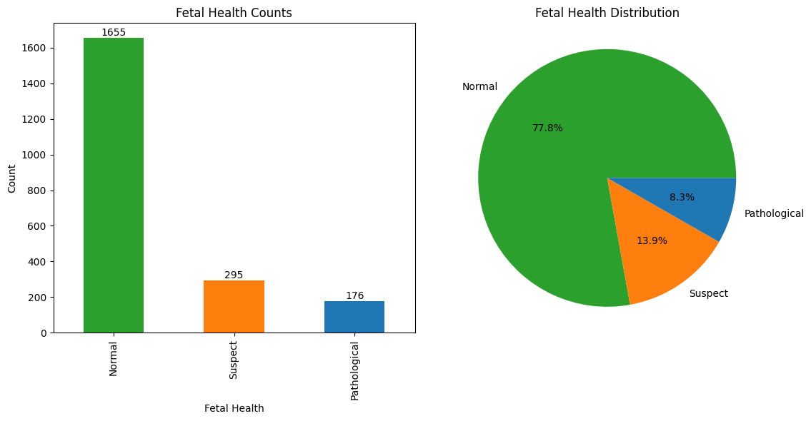
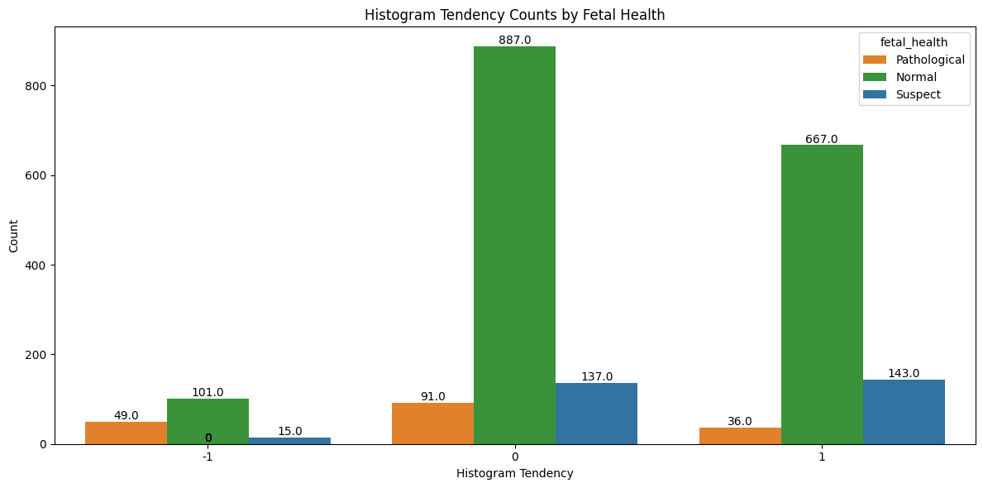
Fetal Health Distribution
The Normal category is distinctively the majority class with 77.9% of the total observations.
The presence of Suspect foetal health category was least for the -1 category of the histogram tendency variable.

Slide 8
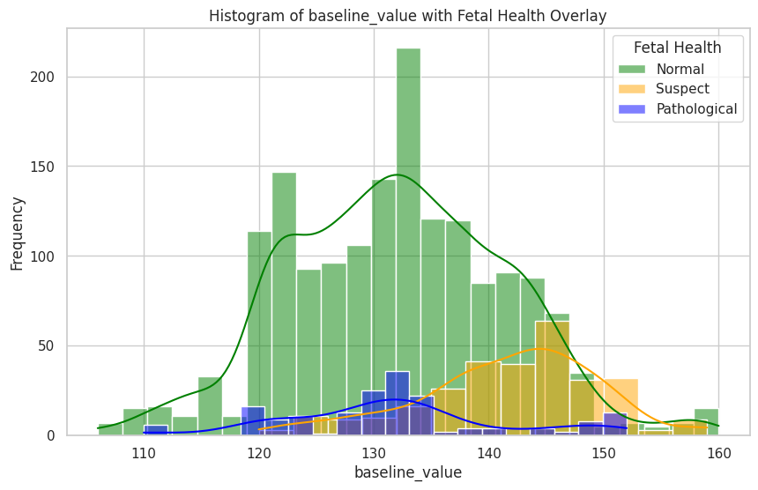
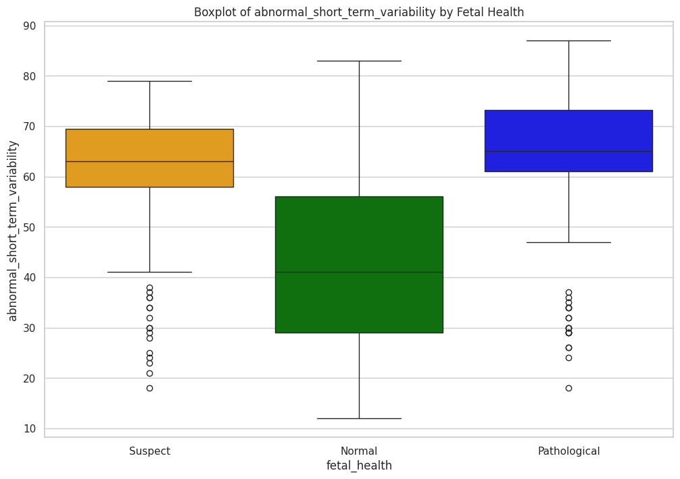
Baseline Value vs Abnormal Short-Term Variability
Most Suspect foetuses had baseline values tending towards the upper bound of the baseline value band.
The Suspect and Pathological foetuses exhibited fewer instances of abnormal short-term variability but had the largest variations.

Slide 9
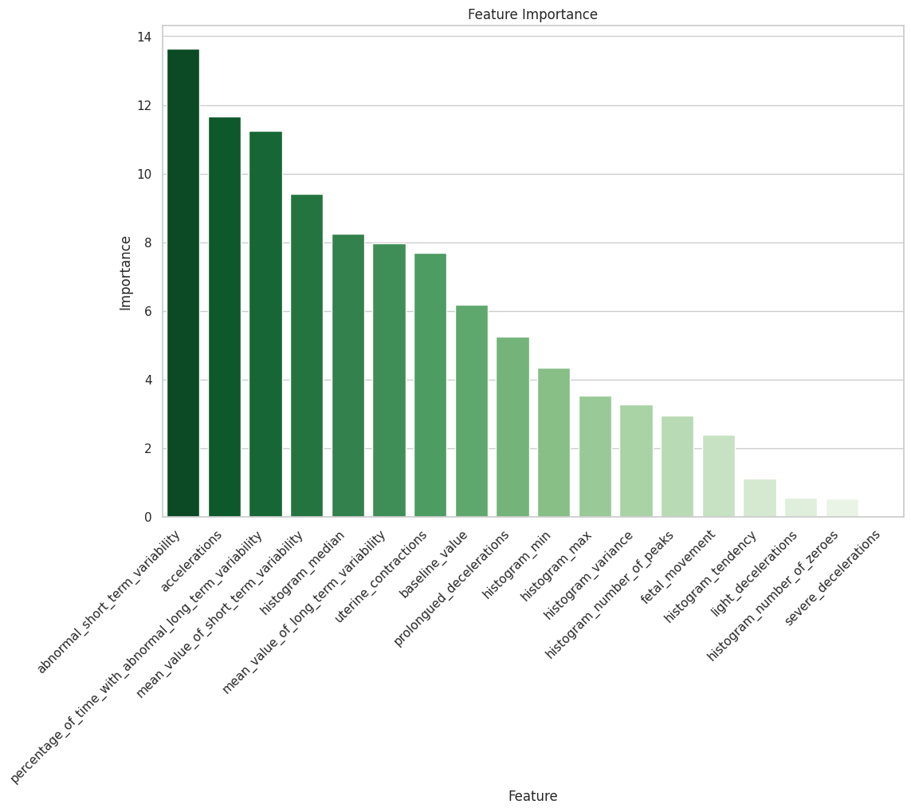
Feature Importance

Slide 10
Models
Evaluation Metrics
Precision, Recall and F1-Score were used to evaluate the candidate models’ performance
Candidate Models
Three models were selected : Random Forest, CatBoost and Multiclass Logistic Regression
Model Optimization
Feature Engineering
SMOTE Analysis
Hyperparameter Tuning
Final Model
Random Forest and CatBoost were selected since they had a tie in performance based on the selected evaluation metrics.

Slide 11
Key Findings
Predictive Features: The analysis revealed that certain features such as abnormal short-term variability, percentage of time with abnormal long-term variability, accelerations, and mean value of short-term variability are the most important for predicting foetal health. Understanding and monitoring these features can provide valuable insights into foetal well-being.
Model Performance: After thorough evaluation and hyperparameter tuning, the analysis found CatBoost and Random Forest as the best performing models for predicting foetal health, achieving an impressive F1-score of 95%. These models provide reliable predictions and can serve as valuable tools for healthcare professionals in assessing foetal health and making informed decisions.
Healthcare Implications: Cardiotocography (CTG) facilitates early detection of fetal distress and congenital heart defects, enabling timely interventions to prevent irreversible harm. CTG can play a crucial role in reducing fetal mortality rates. Integration of predictive models based on CTG features enhances healthcare decision-making, safeguarding maternal and neonatal well-being.

Slide 12
Recommendation
Based on the analysis done and the key findings,
Argument in favour of Precision as a measure of model performance
Emphasize Precision for Critical Decision-making: In cases where the consequences of a false positive prediction (incorrectly labeling a healthy fetus as pathological) are severe, such as unnecessary medical interventions or undue stress for expecting mothers, prioritize precision. Healthcare providers should focus on minimizing false positives to ensure accurate diagnosis and appropriate management of high-risk cases.
Argument in favour of Recall as a measure of model performance
Prioritize Recall for Early Intervention: In situations where the ramifications of a false negative prediction (failing to identify a pathological condition) outweigh the risks associated with false positives, prioritize recall.
Precision
Recall

Slide 13
AI System for Clinical Data Production and Analysis
Artificial Intelligence
Data
Machine Learning
EMR Data
Output
Natural Language Processing
Input
Image, Genetic EP Data
Output
Clinical Notes in Human Language
Clinical Activities: Screening, Diagnosis, Treatment
Generate

Slide 14
Clinical AI Model Deployment
1
2
3
4
Data collection
Model development
Model evaluation
Deployment (post-authorization)
Authorization
Report patient characteristics from training data.
Create datasets with diverse patient cohorts.
Evaluate error rates across different patient cohorts.
Adopt techniques for de-biasing.
Inspect decision logic through explainability.
Compare against prior knowledge.
Use interpretable models.
Monitor post-authorization data (e.g. patient characteristics)
Monitor post-authorization use (e.g. performance)

Slide 15
Performance Payoffs of an AI Model
Reliability and accuracy
Ensuring that the AI model consistently delivers accurate and dependable results across varied scenarios is crucial for maintaining trust and effectiveness.
Robustness
A robust AI model can withstand and perform well under diverse and unforeseen conditions, ensuring consistent performance despite potential disruptions or anomalies.
Transparency
Transparency in an AI model allows users to understand how decisions are made, fostering trust and facilitating easier troubleshooting and improvement of the model.
Fairness and equity
Integrating fairness and equity into the AI model ensures that it provides unbiased outcomes, promoting inclusivity and preventing discrimination against any group.
Safety and privacy
Prioritizing safety and privacy in AI development protects user data and prevents misuse, thereby safeguarding against potential risks and enhancing user confidence.
Fit for purpose
Ensuring that the AI model is tailored to meet specific needs and objectives guarantees that it effectively addresses the intended use cases and delivers maximum value.
Notes:
This template was inserted from Power-user, the productivity add-in for PowerPoint, Excel and Word.
Install Power-user to access thousands of templates, icons, maps, diagrams and charts with Power-user.
Visit https://www.powerusersoftwares.com/
©Power-user SAS, terms of license: https://www.powerusersoftwares.com/terms

Slide 16
Thank You.

